Slide 1
FAUX FIND ALL USERS ‘X’
GROUP 2: AMISH KANJI (CPE)
JOEL GARDYASZ (CPE)
JOSH RADICCHI (EE)

Slide 2
PROJECT PROBLEM AND MOTIVATION
People misplace items of value all the time
They also leave behind their laptops on their way to work
We want to create a product that prevents these things from happening as well as a means to locate the lost item
There are other similar products on the market right now
We want to learn from these implementations and make ours better

Slide 3
GOALS AND OBJECTIVES
To make it so that people don’t “freak out” when they misplace or leave something behind
They will know that they can track it using FAUX
To create a device that is easy to use
To create a mobile application that enables the user to locate their device and the belonging that it was attached to

Slide 4
REQUIREMENTS AND SPECIFICATIONS
The location of the object shall be found by using a smartphone or tablet.
The tracking device shall be of portable size and weight.
The tracker shall be water resilient, and be able to withstand fall damage.
Your smartphone shall respond to the tracker if need be.
The tracker shall produce sounds and light up when prompted.
The tracker shall work well up to 40 feet.
The tracker shall notify the user if the item being tracked gets too far away from the user.
The tracker shall be able to survive for 6 months without a battery change.

Slide 5
PROJECT SUMMARY
Wireless tracking device
Paired with mobile application
Project will have multiple features
Takes into account all possible human senses
Will help users retrieve lost/stolen items
Will also help reduce the chance an item is lost in the first place

Slide 6
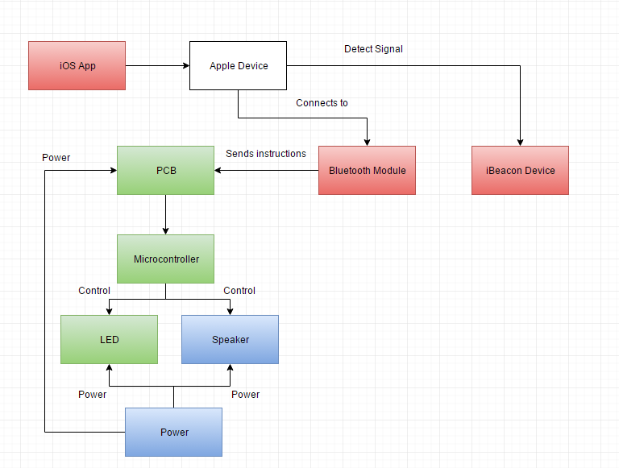
WORK DISTRIBUTION
Amish – Red
Josh – Green
Joel – Blue

Slide 7
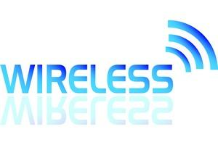
WIRELESS COMMUNICATION
Bluetooth (BLE & iBeacon)
Advantages: Low Battery Consumption, cheap, low latency, integration, range
Disadvantages: Data Rate, strength of signal, receiver battery life, receiver
Wi-Fi
Advantages: Cheap, high data rate, integration, range
Disadvantages: Security, battery consumption, strength of signal
GPS
Advantages: Cheap, integration, range
Disadvantages: Battery consumption, indoor capability, inaccuracy

Slide 8
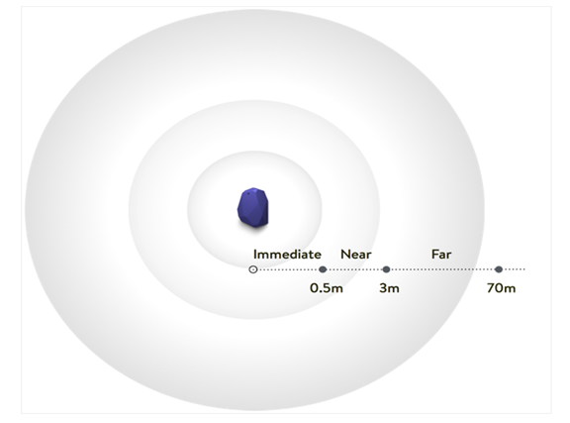
IBEACON
What is iBeacon?
Protocol developed by Apple, referred to as beacons
Broadcast identifier to nearby devices which causes some action
Uses Bluetooth Low Energy
Why iBeacon?
Most other product don’t uses this technology
Always broadcasting
No syncing requirement

Slide 9
ESTIMOTE
Top companies for beacons
Other companies considered: BlueSense, BlueCats, Kontakt
What are Estimote Beacons?
Small wireless sensors
Broadcast radio signals
Devices interpret unlocking micro-location and contextual awareness
Why Estimote?
Estimote SDK
Requirements
Tutorials/community

Slide 10
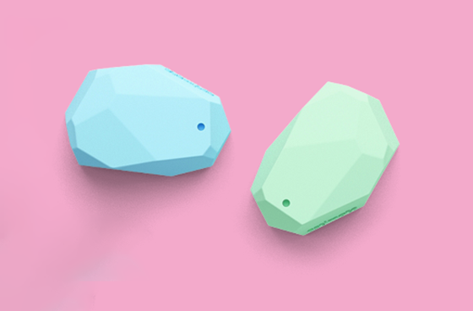
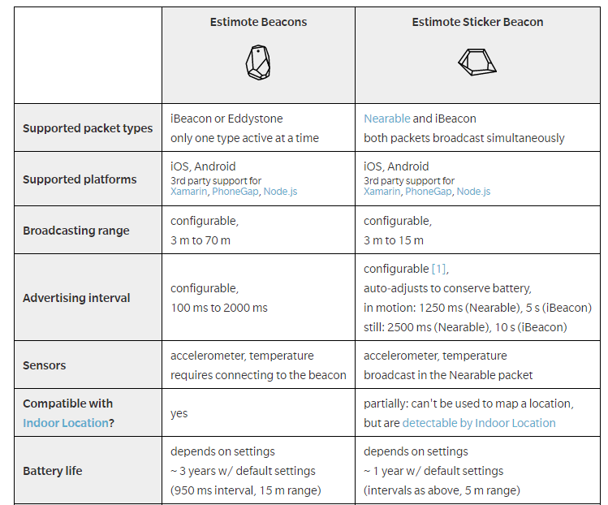
ESTIMOTE BEACONS VS ESTIMOTE STICKERS

Slide 11
ESTIMOTE STICKER
Why Estimote Sticker Beacons?
Size (3 mm thin)
Easier to stick to everyday objects
How are Stickers different?
Packets
More information
iBeacon/Nearables
Examples: ID, motion, power, voltage, temperature
Manufacturer | Estimote
Product | Sticker Beacons
Price | $99
Quantity | 10

Slide 12
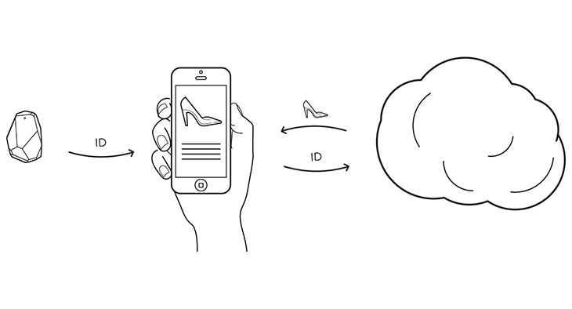
Estimote SDK
Instructions
Access information
Integratable
Multiple environments
Communicated with cloud
Identifier

Slide 13
BLUETOOTH LOW ENERGY (BLE)
Advantages
Has a range of up to 50 feet away.
Has reduced energy consumption.
Very cost effective.
Stays on in the background.
Disadvantages
The signal strength is not always the strongest.
Does not have a high bandwidth.

Slide 14
PUNCH THROUGH
Small hardware company
Creator of the Light Blue Bean
Uses Arduino to program the Bean wirelessly
Uses BLE to wirelessly communicate
Why Punch Through?
Has a Bluetooth module that you
can program wirelessly.
They sell some of the parts that we
need to create the PCB.

Slide 15
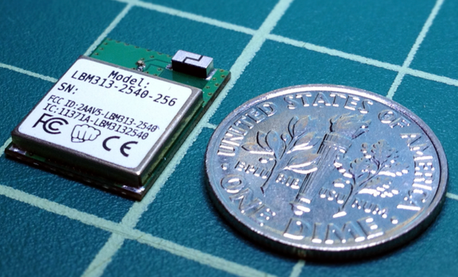
CHOSEN BLE MODULE
LBM313
Key Features:
2.4Ghz Bluetooth low energy
Data rates from 250kbps to 1Mbps
Operating voltage of 2.0V - 3.6V
8051 microcontroller with 256kB of in
system programmable flash and 8kB of
RAM
Manufacturer | Punch Through
Product | LBM313
Price | $10
Quantity | 1

Slide 16
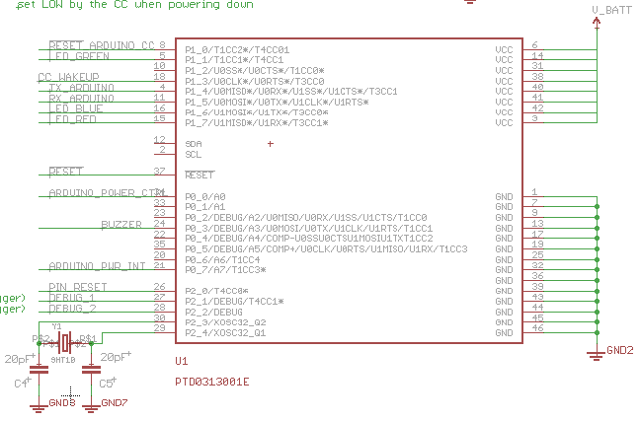
PCB LAYOUT OF BLE MODEL

Slide 17
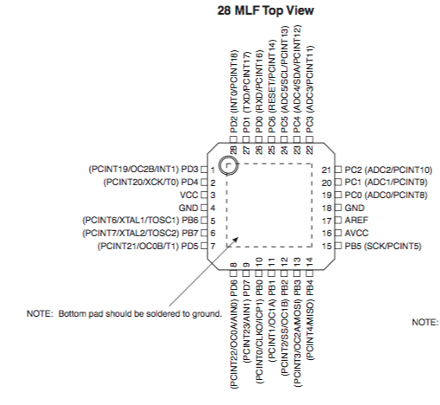
CHOSEN MICROCONTROLLER
Manufacturer | Atmel
Product | ATMEGA 328
Price | $4.95
Quantity | 1
ATMEGA328
Low-power CMOS 8-bit
microcontroller.
Based on the AVR enhanced RISC
architecture.
Allows the system designer to
optimize power consumption

Slide 18
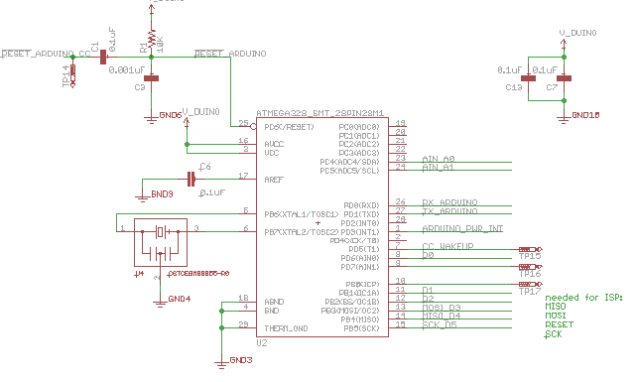
PCB LAYOUT OF MICROCONTROLLER

Slide 19
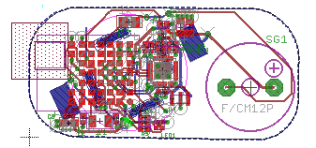
WIRING OF OUR PCB

Slide 20
OUR PCB
Our PCB is made up of:
A Bluetooth module
A microcontroller
A LED
A buzzer
Resistors
Capacitors
N-MOS
Other smaller components
Manufacturer | OSH Park
Product | Printed circuit boards
Price | $7.75
Quantity | 3

Slide 21
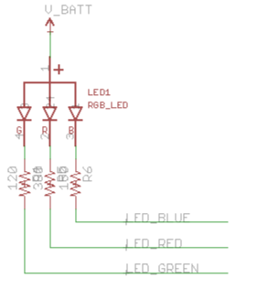
LED
We will be using a RGB LED
Used to find item in the dark
You can choose different colors
Each color has a different
operating voltage.

Slide 22
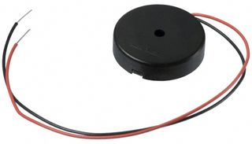
CHOSEN SPEAKER
The speaker’s purpose is to aid the user in locating the device if they are nearby
It adds an auditory component for tracking
We could not use a standard magnetic driven speaker
This would require the addition of an amp which is too big for our design
Manufacturer | Multicomp
Product | Piezo buzzer
Price | $3
Quantity | 1

Slide 23
CHOSEN SPEAKER
Therefore we decided to go with a piezoelectric speaker
The piezo does not need a magnet to produce sound
Creates sound by passing electric charge through a crystal
Uses a lot less energy
More resistant to breaking
Manufacturer | Multicomp
Product | Piezo buzzer
Price | $3
Quantity | 1

Slide 24
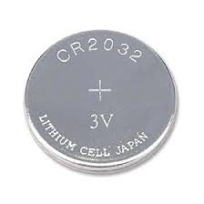
CHOSEN BATTERY
CR2032 (coin cell battery)
Lithium battery
3V
Commonly used in electric devices
Reasoning
Meets voltage requirements of our project
Size
Manufacturer | Energizer
Product | CR2032
Price | $3.49
Quantity | 1

Slide 25
PCB SCHEMATIC

Slide 26
PCB SOFTWARE
Arduino IDE
Used to upload sketches MCU
Microcontroller will then use the sketch to communicate with the other components
Had to be able to communicate with the application as well
Application sends instructions to the BLE module
BLE module sends instructions to the MCU
MCU uses the sketch uploaded via Arduino to fulfill the instructions

Slide 27
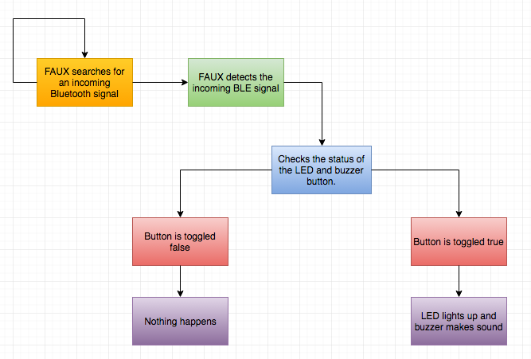
PUT IT TOGETHER

Slide 28
HIGH LEVEL ARCHITECTURE DESIGN

Slide 29
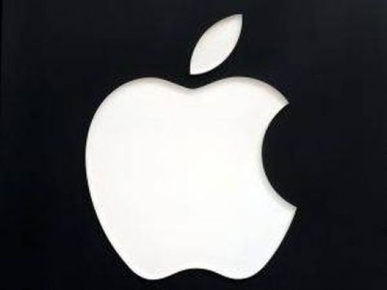
MOBILE APPLICATION – ANDROID VS IOS
>
Practicality
Testing/Debugging
Compatibility
Estimote
Written in Swift or objective-C, less code than Java
Online guide and API reference

Slide 30
MOBILE APPLICATION – DEVELOPMENT ENVIRONMENT
Xcode
IDE dedicated for application design
Programmed using Swift
Software Integration
Included multiple software tools for creation of UI
Creation from scratch
CocoaPods
Dependency manager
Allows for third party libraries to be kept up to date
Integration simplicity

Slide 31
MOBILE APPLICATION - USER INTERFACE
Labels
Zone
Legend
Description/Instructions
Buttons
Reconnect
Components

Slide 32
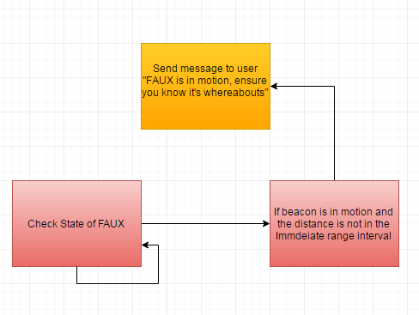
MOBILE APPLICATION - NOTIFICATIONS
Reminders
Alerts

Slide 33
MOBILE APPLICATION - NOTIFICATIONS

Slide 34
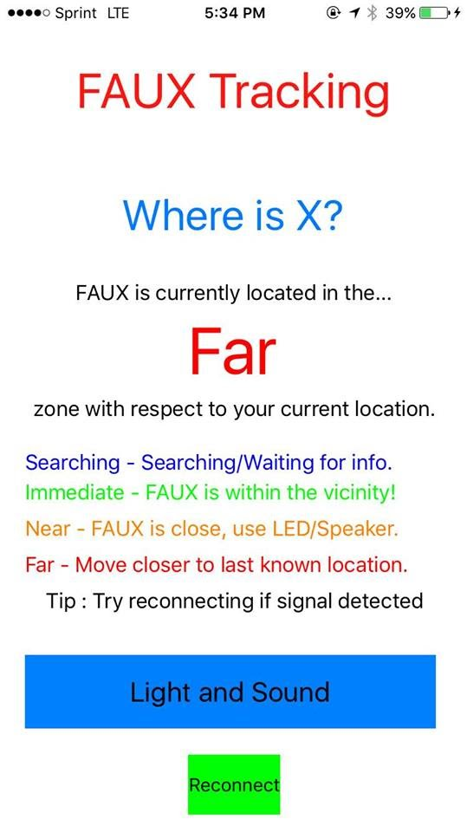
MOBILE APPLICATION – PRIMARY FUNCTION
Tracking
Ranging/Monitoring
Hotter/Colder
User friendly messages/guidance added

Slide 35
MOBILE APPLICATION – PRIMARY FUNCTION

Slide 36
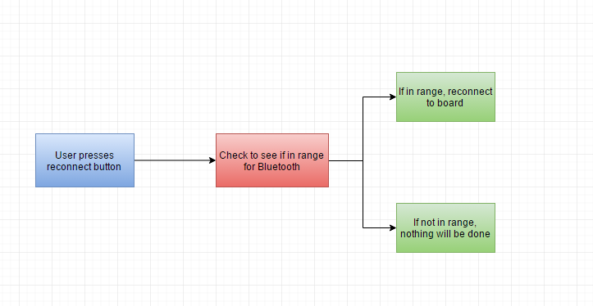
MOBILE APPLICATION – SECONDARY FUNCTIONS

Slide 37
SOFTWARE – SUCCESS AND DIFFICULTIES
Difficulties
Testing
Obstacles
Environment
Distance
Ranging/Monitoring
Signal dependent
Success
Acceptance testing
User friendly mobile application
Negligible learning curve
Features can be successfully completed
No issues occur when in correct range
End goal is achieved without any errors

Slide 38
HARDWARE – SUCCESS AND DIFFICULTIES
Difficulties
Making the PCB as small as it possibly could be
Printing and populating the board
OSH Park
QMS
Success
Being able to make a backup
Testing
Light up
Make sound

Slide 39
PROTECTIVE CASE
3D printed using ABS plastic
Water resistant
Durable
Customizable

Slide 40
BUDGET AND FINANCING
Part | Cost Per Unit | Quantity | Total Cost
iOS Device | Already Owned | 1 | $0.00
LightBlue Bean | $30.00 | 1 | $30.00
Casing (3D printed) | $0.00 | 1 | $0.00
Speaker | $3.00 | 1 | $3.00
Estimote Sticker Beacons | $100.00 | 10 | $100.00
LBM 313 | $10.00 | 1 | $10.00
ATMEGA328 | $5.00 | 1 | $5.00
Misc. Parts | $50.00 | NA | $50.00
PCB | $2.58 | 33 | $7.75
Total Cost |  |  | $205.75
Most of the materials for the project were either already owned by someone in the group or were relatively inexpensive
Therefore, the entire project was funded by the members of the group

Slide 41
QUESTIONS?

